Slide 1
Introduction to study documents
Release Date: DD-Mmm-YYYY

Slide 2
Study documents
Protocol
Case Report Forms (CRFs)
CRF Completion Guideline
Annotated CRFs
Statistical Analysis Plan
Database Management
Specifications
Mock Shells
ADS
TLFs
Report/Manuscript

Slide 3
Protocol
The study protocol is the blueprint that all researchers follow.
A study protocol is a document that describes, in detail, the plan for conducting the clinical study. The study protocol explains the purpose and function of the study as well as how to carry it out.
Typically Protocol includes following:
The reason for the study
The number of participants
Eligibility and exclusion criteria
Details of the intervention or therapy the participants will receive (such as frequency and dosages),
What data will be gathered
What demographic information about the participants will be gathered
Steps for clinical caregivers to carry out
Study endpoints.

Slide 4
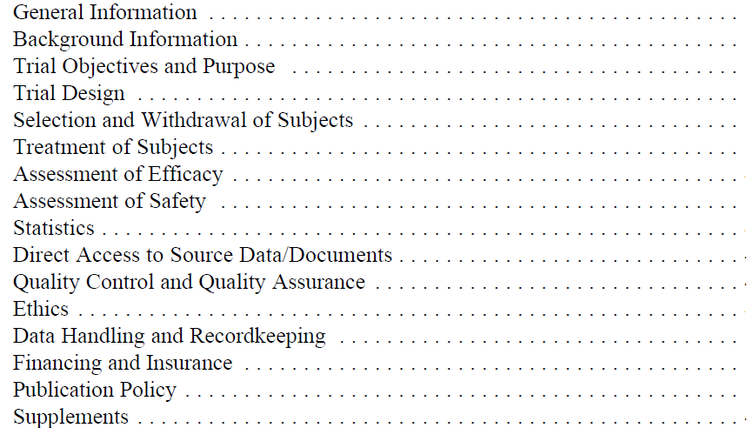
Contents of Protocol (as per ICH guidelines)

Slide 5
Protocol Development
Objectives PI
Definition of Endpoints
Study Design
Sample size
Analysis Plan BS
PI: Principal/Clinical Investigator; BS: Study Biostatistician

Slide 6
Biostatistician – Protocol Writing
Objectives (input)
Endpoints (input)
Study Design (input)
Randomization procedures (writes)
Allocation concealment (input)
Sample size (writes)
Analysis plan (writes)

Slide 7
Biostatistician – Protocol Review
It is highly recommended that the Biostatistician reviews the full protocol prior to final review/sign-off:
– Clarity
– Completeness
– Consistency
– Data quality issues
– Feasibility

Slide 8
Biostatistician- Objectives and endpoints
Based on the objective/clinical research question
Valuable information on key design inputs
Clear specification of hypotheses to be tested (or parameters to be estimated)
Selection and definition of endpoints (Primary outcome variable)

Slide 9
Biostatistician- Study Design
Is the study design appropriate to provide the data needed to answer the objectives?
Eligibility criteria
Selection/recruitment of Participants:
- Define procedures for minimizing selection bias
- If an RCT, define randomization procedures (sequence generation, and allocation concealment), blinding
Length of follow up and frequency of contacts

Slide 10
Biostatistician- Sample Size
Justification in terms of power or precision for the primary endpoint
Method used to calculate the sample size
– Should be consistent with the primary method for data analysis, and appropriate for the study design
Historical data to support the assumptions
Justification in terms of feasibility

Slide 11
Statistical Programmers - Read and Understand study Protocol
Protocol Synopsis
Study Design
Inclusion and Exclusion criteria
Schedule of assessment
Study Flow Chart
Endpoints
Statistical Methods

Slide 12
Game
Divide the team into groups and ask them to read the study protocol and make presentation/questions on
(1) Study Design
(2) Inclusion Exclusion Criteria
(3) Primary/ secondary endpoints
(4) Visit schedule
(5) Statistical methods

Slide 13
Study documents
Protocol
Case Report Forms (CRFs)
CRF Completion Guideline
Annotated CRFs
Statistical Analysis Plan
Database Management
Specifications
Mock Shells
ADS
TLFs
Report/Manuscript

Slide 14
Case Report Forms
A case report form (CRF) is a data collection tool used in clinical trials to support investigators and coordinators in capturing all protocol-required information.
The International Conference on Harmonization Guidelines for Good Clinical Practice define the CRF as: A printed, optical or electronic document designed to record all of the protocol – required information to be reported to the sponsor on each trial subject.
A well-designed CRF should represent the essential contents of the study protocol and in an ideal situation, CRF is designed once the study protocol is finalized.
The data from the CRFs is compiled as a dataset into a database and validated prior to statistical analysis.
Paper CRF is the traditional way of data capture and a better option if studies are small or vary in design, whereas eCRFs are considered if studies are large with similar designs.
eCRFs are preferred over paper CRFs as they are less time-consuming, and also encourage the sponsor/pharmaceutical company to carry out large multicentric studies at the same time due to the ease of administration.

Slide 15
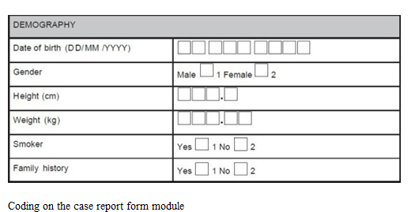
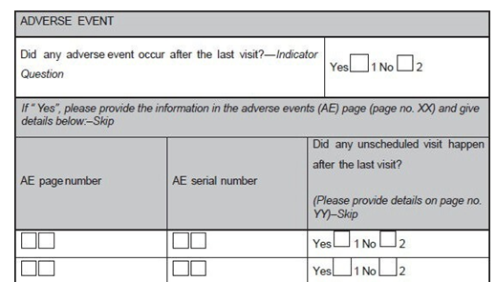
Examples of CRF

Slide 16
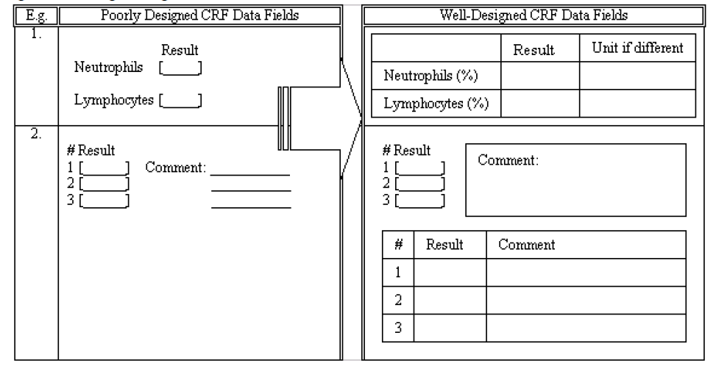
Poorly designed v/s Well-designed CRFs

Slide 17
CRF completion Guideline
The guidelines help to bridge the gap between the study protocol and the users in regards to CRF completion, correction, signing and handling procedures.
Data formats for appropriate response fields, a data correction guide, how to handle unknown or unavailable data, and a retrieval schedule for completed CRFs can be outlined.
instruct how to handle missing or unavailable data. If a required piece of information or entire section cannot be retrieved, the use of “NA”, “ND” or “UNK” can be defined to avoid ambiguous responses.
The guidelines can also demonstrate how to complete CRF pages for unscheduled assessments or in the cumulative log.
Furthermore, CRF retrieval procedures including how to handle CRFs for subjects who have discontinued during the study can be listed.

Slide 18
Annotated CRFs
What This is a blank CRF annotations that document the location of the data with the corresponding names of the datasets and the names of those variables included in the submitted datasets
Annotations are meant to help the FDA reviewer find the origin of data variables included in the submitted datasets
Annotations should reflect the data submitted within the SDTM

Slide 19
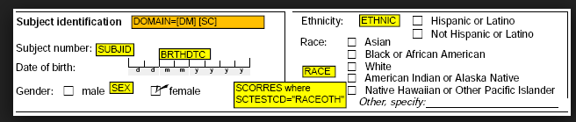
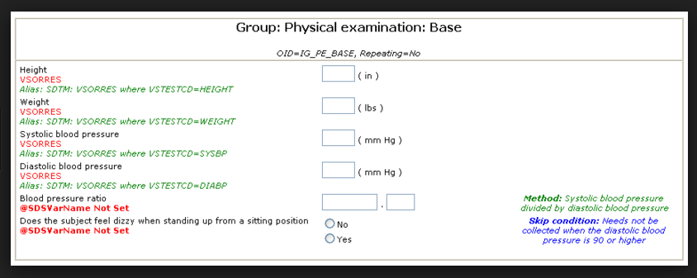
Examples of Annotated CRF

Slide 20
Statistical Programmers: CRF Design/CRF review/ Read and Understand CRF
CRF/eCRF design
Since statistical SAS programmers have an in-depth knowledge of each data point utilized in the programming, their involvement can help to ensure that critical data points are collected efficiently via CRF/eCRF.
Example, concomitant therapy reporting, in order to differentiate a prior therapy from a concomitant therapy, either a date or a flag needs to be collected via CRF/eCRF. Without that, it will be extremely difficult to differentiate prior therapies from concomitant therapies in the programming.
Read and understand CRF, CRF completion guidelines
Check if all required information is captured on CRF
Read CRF completion guideline to understand how data is captured on CRF
Try to visualize mapping of variables in different SDTMs

Slide 21
Statistical Programmers: Annoation of CRF/Review of CRF
In addition to CRF/eCRF design, statistical SAS programmers are also often expected to play a significant role in mapping each and every CRF/eCRF data point in to the database.
To perform this activity, they should be familiar with industry quality standards, guidelines and procedures. For example, a good knowledge of the Study Data Tabulation Model (SDTM), which defines a standard structure for study data tabulations that are to be submitted as part of a product application to a regulatory authority such as the United States Food and Drug Administration (FDA), is definitely helpful.
How to Annotate?
Make a list of SDTMs/ Source datasets
For each variable captured on CRF page, try to map to a SDTM/Source data set
Create a excel sheet which will have a variable name from CRF and a destination dataset name

Slide 22
Exercise
Annotation of CRF page or provide annotated CRF pages to understand the annotations

Slide 23
Study documents
Protocol
Case Report Forms (CRFs)
CRF Completion Guideline
Annotated CRFs
Statistical Analysis Plan
Database Management
Specifications
Mock Shells
ADS
TLFs
Report/Manuscript

Slide 24
Statistical Analysis Plan
A statistical analysis plan (SAP) describes the planned analysis for a clinical trial.
Protocol outlines the analysis, SAP describes the statistical techniques for study analysis in detail.
The SAP defines all the statistical output which will be included in the clinical study report.
Shell tables, figures and sometimes listings are usually attached to the SAP although they should not be formally part of the SAP.
Usually the SAP is written by the trial or project statistician by using a template.
According to ICH E9 the statistical analysis is planned a priori.
Notes:
All statistical programming deliverables are defined in SAP

Slide 25
Statistical Analysis Plan (Contd…)
Clinical trial statistician needs to ensure that the SAP is carefully reviewed and approved prior to unblinding of the study.
For open label studies the SAP should be reviewed and approved prior to database lock approval.
The SAP is a document which is submitted to regulatory authorities as part of a submissions package.
The SAP is part of the appendix of a clinical study report.
The SAP is stored in the trial master file and it is used during audits to check if statistical programming followed exactly the descriptions in the SAP.
Besides the technical statistical details it should contain brief descriptions and summaries of the protocol, rather than just referring to the protocol.

Slide 26
Contents of SAP
Brief description of the study and purpose – e.g. description of conduct details which are important for analysis, study objectives and variables
Statistical methods to be used – e.g. summary statistics of subject data (means, standard deviations, extreme values, counts with corresponding percents), statistical tests (analysis of variance, t-tests, )
Description of analysis populations – e.g. safety set, per protocol set, full analysis set, Data handling rules – e.g. imputation rules, algorithms for derived variables
Complete table of contents with all TFLs to be produced by the statistical programmer as attachment to the SAP text (i.e. not as an appendix or any other formal and official part of the SAP)
Shell TFLs to be produced by the statistical programmer to define the layout of the TFLs as attachment to the SAP text (i.e. not as an appendix or any other formal and official part of the SAP)

Slide 27
Biostatistician - Statistical Analysis Plan Summary
Provides the statistical methodology for the assessment of the primary objective(s):
– Statistical Hypotheses and testing procedures
– Primary Analysis Population
– Secondary analysis
– Sensitivity analysis
Missing data
Multiplicity of testing
Subgroup analyses, covariates
Statistical method(s) for Secondary or Exploratory objectives(s)

Slide 28
Biostatistician- Statistical Analysis Plan Summary
Discusses statistical methods to be used in planned interim analyses, if any (Role of a DSMB).
Purposes:
– Assuring objectives can be achieved
– Justifying design and data collection
– Justifying the statistical test and procedure

Slide 29
Biostatistician- Data Analysis - 1
Write a detailed analysis plan:
– Define Primary and Secondary endpoints
– All hypothesis to be tested and testing procedures (or parameters to estimate)
– Analysis populations
– Interim analysis and adjustments to type I error
– Hierarchy of analysis
– Handling of missing data
– Subgroup analysis
– Exploratory analysis, if any

Slide 30
Biostatistician- Data Analysis - 2
Variable Types and Derivations to be described in the Analysis Plan
Categorical ( Binary or dichotomous)
– Sex ( Male, female), diabetes (type 1, type 2)
Ordinal
– Attitudes (strongly disagree, disagree, neutral, agree, strongly agree)
– Cancer stage (I, II, III, IV)
Numerical
– Discrete (Number of abnormal cells)
– Continuous (Age; Serum Creatinine level)
Derived
– Absolute % change, Time to response, AUC

Slide 31
Biostatistician- Data Analysis - 3
Should be written prior to un-blinded review of the data or even prior to data collection (First Subject in):
– Helps to prepare for report and manuscript writing
– Helps in the validity and credibility of the results

Slide 32
Statistical Programmers- Read and Understand SAP
Study Plan
Study design and objectives
Analysis Population
Analysis of Endpoints
Baseline Definitions
Imputation rules , if any
Data Handling rules , if any
Statistical methods
Interim Analysis, if applicable
Database Lock

Slide 33
Game : Reading SAP
Read study SAP and Discuss Key points

Slide 34
Study documents
Protocol
Case Report Forms (CRFs)
CRF Completion Guideline
Annotated CRFs
Statistical Analysis Plan
Database Management
Specifications
Mock Shells
ADS
TLFs
Report/Manuscript

Slide 35
Database Management
Biostatisticians and Statistical programmers are involved in providing inputs to Database creation
In next few slides we will learn about different activities which they support

Slide 36
Biostatistician: Input to Data Management
CRF Development:
– Content
– Design
Dataset specification:
– Annotation of CRFs
– Record Layout
Validation:
– Error checking specification
– Test data

Slide 37
Statistical Programmers: Database set up
SAS Programmers may be involved in Database set up activities to support Clinical Data Management team. Some of the activities can be :
Edit checks programming
Metadata Setup- Phase, treatment groups, Baseline flags etc
Raising Data issues identified during programming

Slide 38
Statistical Programmers: Database UAT
A good database is critical for final reporting.
Statistical SAS programmers are often expected to be involved in the database UAT because of the close relationship between database quality and accurate reporting.
Database UAT is done after the database design using mock data to check each and every data point is collected properly.
A key data point missing or incorrect collection can have a negative effect on lots of other seemingly-unrelated data points and also negative effect the programming.
For example, a missing study medication date can effect phasing. A good statistical SAS programmer can definitely contribute a lot in the establishment of a database in high quality.

Slide 39
Study documents
Protocol
Case Report Forms (CRFs)
CRF Completion Guideline
Annotated CRFs
Statistical Analysis Plan
Database Management
Specifications
Mock Shells
ADS
TLF
Report/Manuscript

Slide 40
Statistical Programmers: Specifications
Specifications are data derivation rules for creating variables required in Source datasets/ Analysis Datasets
Specifications should provide details of attributes along with derivation rules for each variable in Source/Analysis dataset
If you follow CDSIC data standards then you need to follow SDTM and ADaM Guideline while writing data derivation rules

Slide 41
Statistical Programmers: Table Shells
Shells are layout of how you want to present data in a Table, Listing or Figure
Shells should provide relevant Titles and Footnotes
If Possible provide programming notes to clarify the information presented in Shell.

Slide 42
Statistical Programmers :Write Data Definition files
Follow SDTM/ ADaM Guidelines/ Client specific Guidelines or work instructions as applicable
Write data derivation rule in Simple English
Do not provide programming statements as data derivation rules. E.g if age<50 then agegrp=1
Do not give reference of Source dataset while writing data derivation rules of ADaMs ; instead give reference of CRF page
Where ever required provide detailed Notes explaining derivation rule.

Slide 43
Statistical Programmers: Create SDTM/ADaMs
Follow Programming standards, as applicable
Write Generic program, try to visualize data captured on CRF and write code which will take care of all data points
Avoid Hard coding, in case you need to do hardcoding discuss with Client and get the reason for hardcoding documented
Write programming comments , while you develop program
Perform Self qc using qc checklist , if available. If no qc checklist is available then create a qc checklist
Ensure program is creating required results, all variable attributes are as mentioned in define file
If you are using standard macros for creating SDTM/ADaMs ensure you understand the macro documentation well before using them.
Sample program < Can we add one or two examples from Davita?>

Slide 44
Statistical Programmers : Validate SDTM/ADaMs
Follow Programming standards/SOP, as applicable
If you are an independent programmer ,then you can start writing validation code once the data definition file is finalized.
Objective of double programming is to create an independent code.
Once the independent code is complete and the first line output is ready for validation, you can compare the datasets and try to identify reasons for differences, if any
Ensure that both datasets (first line and validation) are run on same data and follow same version of data definition file
Sample program < Can we add one or two examples from Davita?>

Slide 45
Statistical Programmers : Create TLFs
Follow Programming standards/SOP, as applicable
Program should produce a report as per Table shell (including indentation, display of percentages, titles, footnotes etc)
Read SAP/ programming standards to understand how percentages need to be calculated (based on N or based on non missing values of a category etc)
While creating figures, make sure that size of the figure is not too small or too large.
If you are using standard macros for creating TLFs ensure you understand the macro documentation well before using them.
Sample mock shell and program < Can we add one or two examples from Davita?>

Slide 46
Statistical Programmers : Validate TLFs
Follow Programming standards/SOP, as applicable
Check for Report layout, title, footnotes, numbers presented in report, spellings etc
For Listings which flow on to many pages, make sure that all pages are displaying required information.
For Figures, check for correctness of numbers using the final dataset which is passed to a SAS procedure that creates figure.
If possible , cross check Listings and summary tables of same domain. E.g AE listing and AE summary table
Sample mock shell and program < Can we add one or two examples from Davita?>

Slide 47
Study documents
Protocol
Case Report Forms (CRFs)
CRF Completion Guideline
Annotated CRFs
Statistical Analysis Plan
Database
Specifications
Mock Shells
ADS
TLFs
Report/Manuscript

Slide 48
Biostatistician: Report/Manuscript Writing
Method Section:
– Description of the data (design, endpoints)
– Statistical Methodology
Result Section:
– Data présentation (tables, graphs, etc.)
Discussion Section:
– Appropriate interpretation of results.
Usually the third author in papers

Slide 49
Summary
Biostatistician Role
Programmer Role

Slide 50
Biostatistician Role
• Protocol Development
• Data Management
• Study Implementation
• Study Monitoring
• Data Analysis
• Report/Manuscript Writing

Slide 51
Study Implementation
Sampling Selection
Implementation of Randomization procedures
– Typically performed by an Independent Biostatistician with the instructions provided by the Study Biostatistician(e.g. Block size)

Slide 52
Study Monitoring
Monitoring for Quality
Monitoring for Safety/Efficacy:
– Use of an Independent Biostatistician
– Study Biostatistician still responsible for the content, analysis methodology, and data transfer coordination

Slide 53
Biostatistician Role
The Biostatistician should be involved in most aspects of a study
– Plays a major role in protocol development,
– Writes detailed statistical Analysis plan
– DM review, interim reporting, and data analysis
The Biostatistician ensures that ICH E9 guidelines on Statistical Principles are followed to:
– Minimize Bias and Maximize Precision
The Biostatistician cares about data because s/he does the analysis, so s/he should be involved in any/all aspect/decision related to the data

Slide 54
Programmers Role
Read and Understand study Protocol
Read and understand CRF, CRF completion guidelines
Annotate CRFs(if required) or review Annotated CRFs
Read SAP
Database set up
Database UAT
Write Define files for SDTM/ADaMs
Create SDTM/ADaMs
Validate SDTM/ADaMs
Create TLFs
Validate TLFs

Slide 55
Thank You

